Slide 1

Smart Blind Stick
Smart electronic aid for blind people
MD. Mominul Islam Shizan - 18.02.04.117
Afridi Rahman Bondhon - 18.02.04.128
Nurul Amin - 18.02.04.130
Mosiur Rahman - 16.01.04.122

Slide 2

Contents
Slide no: 3
Objectives
Slide no: 4
Social Values
Slide no: 5
Required Components
Slide no: 6
Working Procedure
Slide no: 7
Budget Comparison
Slide no: 8
Contribution of team-Members
Slide no: 9
Challenges of the Project
Slide no: 10
Conclusion

Slide 3
OBJECTIVE
Enables the blind people to move with same ease and
confidence as sighted people
People who are both deaf and blind will also be benefited with this
Update a normal stick into smart multi functional stick

Slide 4

SOCIAL VALUE
Ensure Safety
A
Reduce Accident
B
C
Cost Efficient

Slide 5
Required Components
ArduinoUNO
PVC Pipe
Jumperwire
9 Volt Battery
Switch
Hand Gloves
Ultrasonic Sensor
Water level sensor
Mini Servo

Slide 6
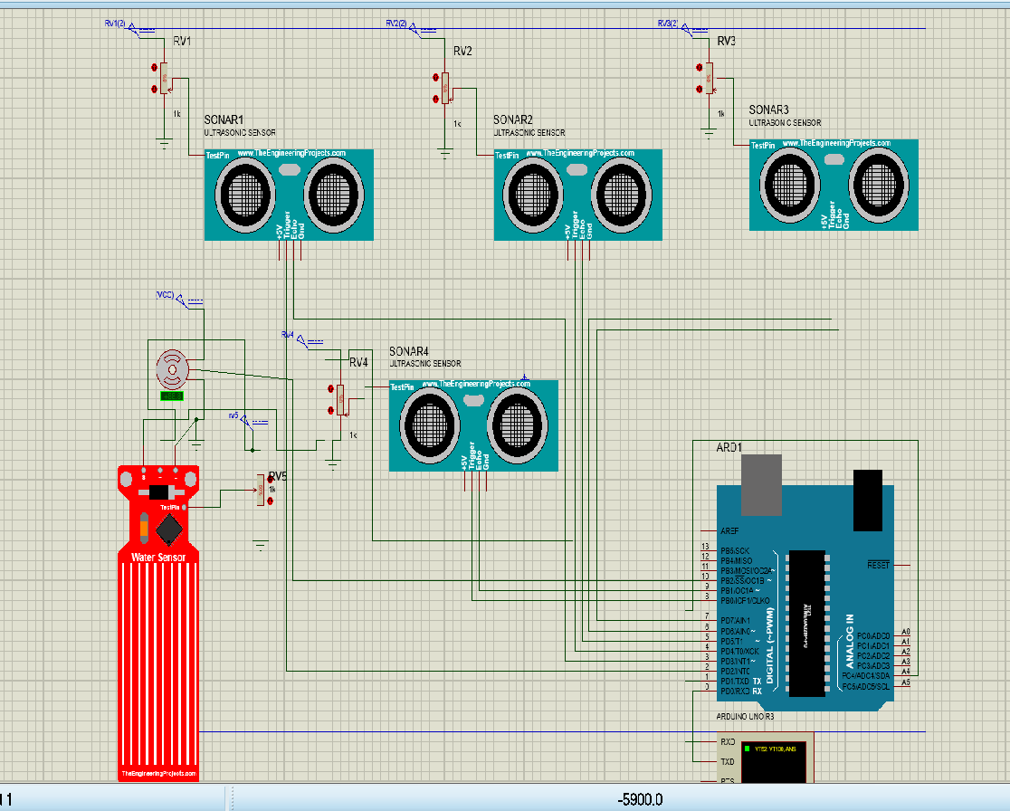
Working Procedure
Checking object in front of blind persons’
Checking water on the way.
Checking holes or unwanted slope on the way

Slide 7
Budget Comparison
Initial Equipment | Initial Quantity | Initial Budget (Tk) | Final Equipment | Final Quantity | Final Expenditure (Tk)
Arduino UNO | 1 | 670 | Arduino UNO | 1 | 800
PVC Pipe | 1 | 100 | PVC Pipe | 1 | 90
Ultrasonic Sensor | 7 | 700 | Ultrasonic Sensor | 4 | 300
GPS & GSM | 1 | 1930 | x | x | x
Jumper wire | As required | 100 | Jumper wire | As required | 90
9 Volt Battery | 1 | 40 | 9 Volt Battery | 2 | 140
Switch | 1 | 5 | Switch | 1 | 10
Mini Servo SG90 | 1 | 195 | Mini Servo SG90 | 1 | 120
Water level sensor | 1 | 250 | Water level sensor | 1 | 100
Active Buzzer | 1 | 15 | x | x | x
Resistor | As required | 20 | x | x | x
 |  |  | ScotchTape | 2 | 40
 |  |  | Hand Gloves | 1 | 40
Total |  | 4025 |  |  | 1730

Slide 8
Contribution of team-Members
MD. Mominul Islam Shizan - 18.02.04.117 25%
Afridi Rahman Bondhon - 18.02.04.128 25%
Nurul Amin - 18.02.04.130 25%
Mosiur Rahman - 16.01.04.122 25%

Slide 9
Challenges of the Project
loose connection problem
low power supply
water sensor detects water automatically

Slide 10
Conclusion
This Arduino Based Smart Blind Stick project proposed the design and architecture of a new concept of Smart Stick for blind people.
The advantage of this project lies in the fact that it can prove to be a very low cost solution to millions of blind person worldwide.
Therefore, the solution for this major problem is proposed by designing a stick that can aid the person to walk safely without having fear of hitting someone on the way or any solid objects.

Slide 11
Thank You
Any Question?

